Slide 1
Airfare prediction analysis

Slide 2
Contents
Data pre-processing
1
Model building
2
Deployement using flask
3

Slide 3
1. Data pre-processing

Slide 4
Objective
The main goal of the project is to predict airfare for next 30 days (2019-06-11 to 2019-07-10)
We have raw data of air fare which contain 2,78,467 rows and 4 columns
Airlines will sell there tickets on variety of fare types, but as per our
project requirement we only have to predict consolidatory fare or NetFare
Research Topics :- (Domain knowledge, computational statistic,
aircraft info, Airport, pre-processing, EDA, Model Building,
Deployment using flask.)

Slide 5
Dataset Summary:
Dataset: - The dataset that is received from client have the following details
Variables are –
Invoice Date: - This provide time stamp information at which a particular product is sold
Itinerary Type :- It’s contain two different travel routes, i.e Domestic and International
Net Fare :- Airlines do not sell there tickets directly to the customer
NetFare is the fare associated with the travel agent
Product Type: - This provide information about the type of product being sold

Slide 6
Exploratory Data Analysis [EDA]:
InvoiceDate variable contains Two year’s of data, namely 2018 & 2019
In InvoiceDate year 2019 holds (75.30%) more records compared to 2018 (24.70%)
NetFare variable contains Negative , Positive and Zero records as well
ProductType contains total 14 types of product which are related to airline
Product type “Air” have more records compared to other product and payment combined
Our aim is to predict the Airfare so we choose “air” only in Product Type, and one more reason is ProductTypes are independent of each other, Egs: refund, we don’t know specifically for which plane(exactly route time and date) refund is issued

Slide 7
Exploratory Data Analysis [EDA]:
Observation around Invoice time vs Net fare is data looks more centralized around the mean from 2AM to 7AM after that it picks up gradually as the hour of the day increases
When we plot Invoice day with Net fare Monday, Saturday & Friday had high avg NetFare compared to the remaining days. Which Re-proves domain knowledge what we have
We took avg of each Invoice date and we filled the missing dates with the forward fill

Slide 8
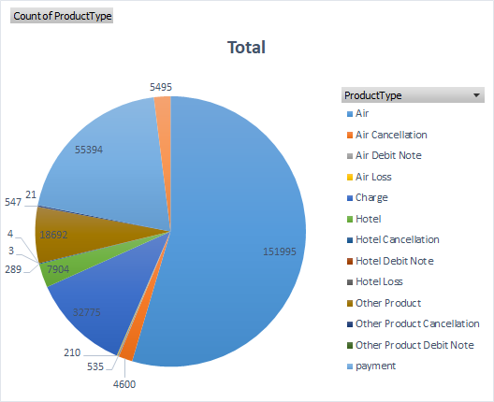
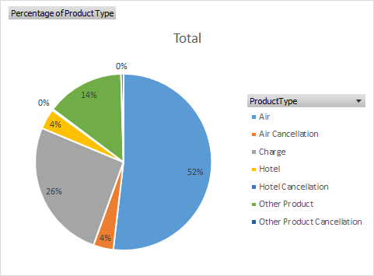
Exploratory Data Analysis [EDA]:
ProductType contains almost 32,777 of blanks, we removed all those blanks.
We observed presence of outliers in our data, we used z score method to remove outliers.
Count of Product Types before doing data preprocessing
Percentage of Product Types for both Domestic and International
after removing blank Net Fare Values

Slide 9
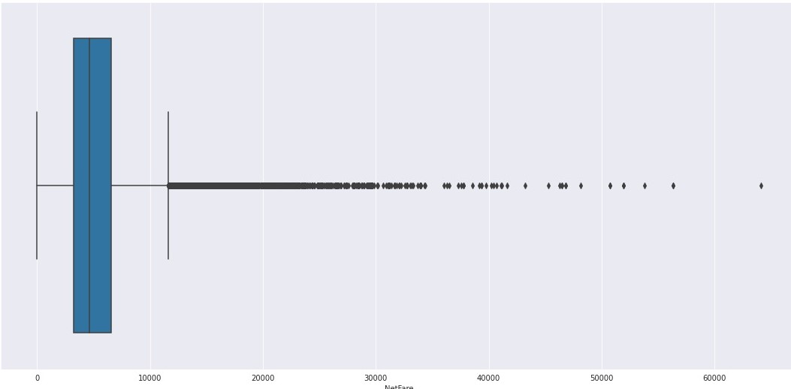
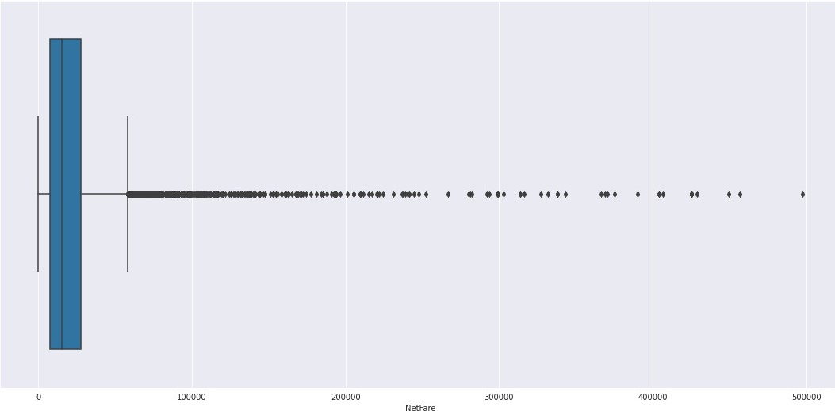
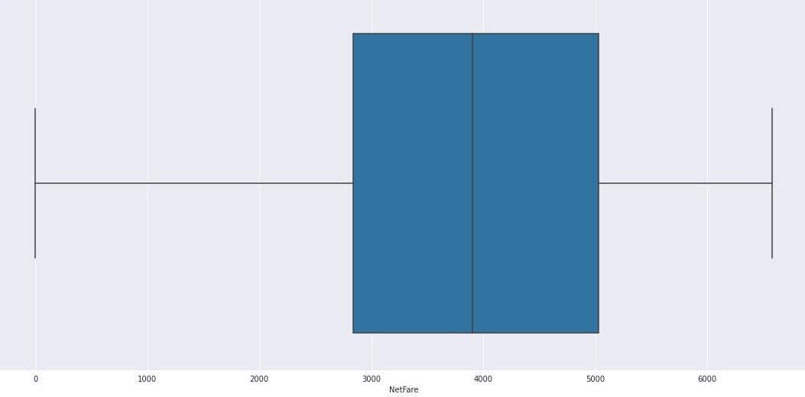
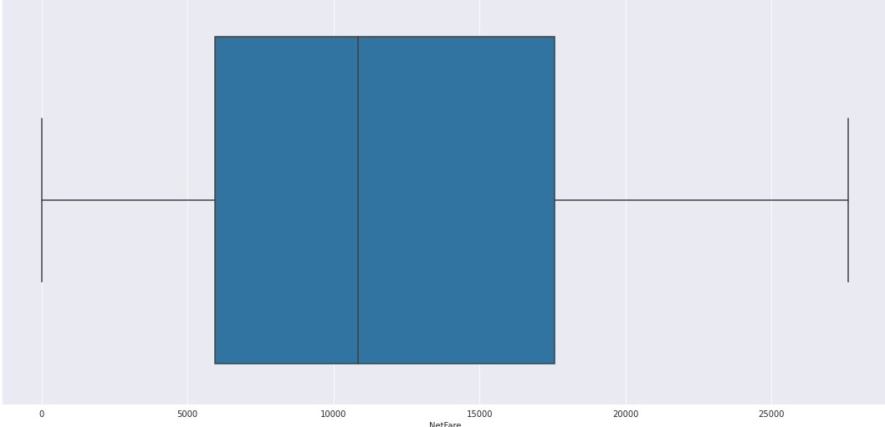
Outliers
Domestic
International

Slide 10
2. Model Building

Slide 11
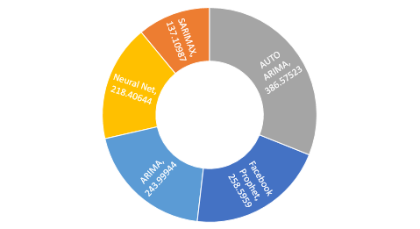
Domestic flight
Models | RMSE
ARIMA | 243.9
SARIMAX | 137.1
AUTO ARIMA | 386.5
LSTM | 218.4
FB Prophet | 258.59

Slide 12
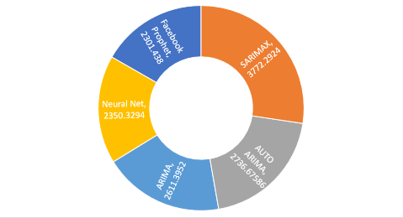
International flight.
Models | RMSE
ARIMA | 2611.3
SARIMAX | 3772.2
AUTO ARIMA | 2736.6
Neural Net | 2350.3
FB Prophet | 2301.4

Slide 13
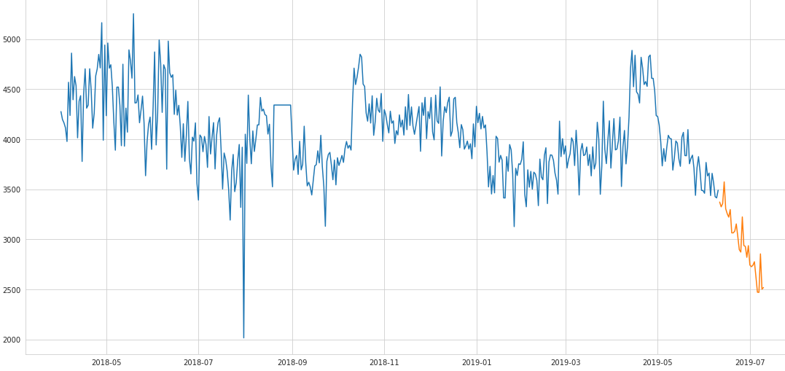
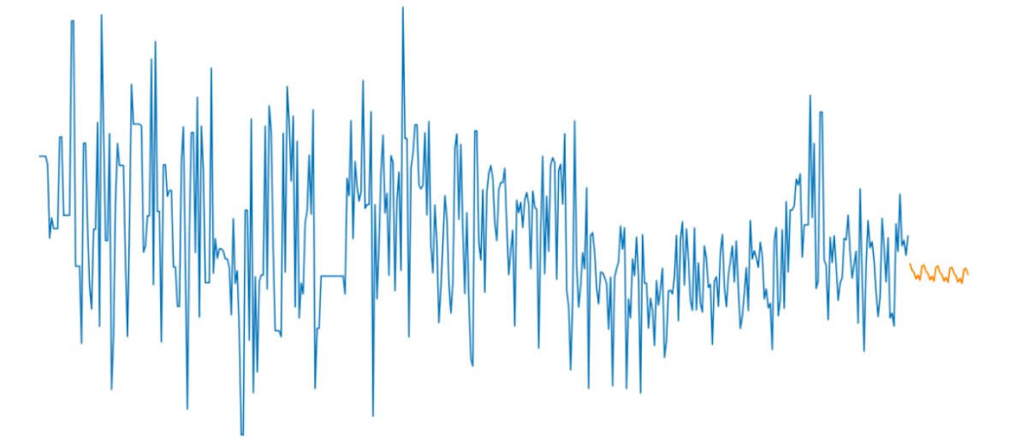
Forecasting
Domestic
International

Slide 14
3. Deployment using flask

Slide 15
Deployment
We used Flask framework for the deployment
Using Html & CSS & Bootstrap we created the front page
where user can interface airfare for domestic and international itinerarytype
prediction is limited to next 30 days only

Slide 16
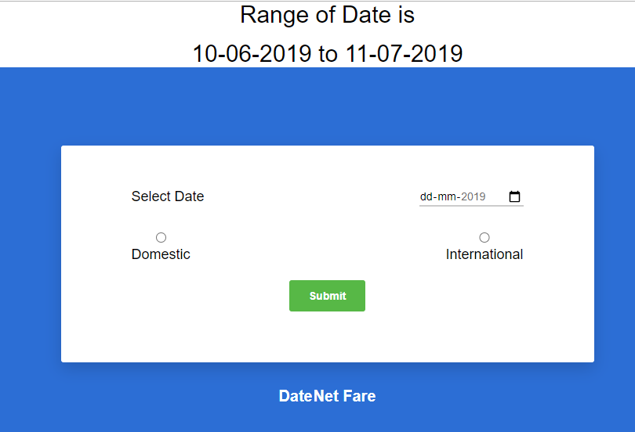
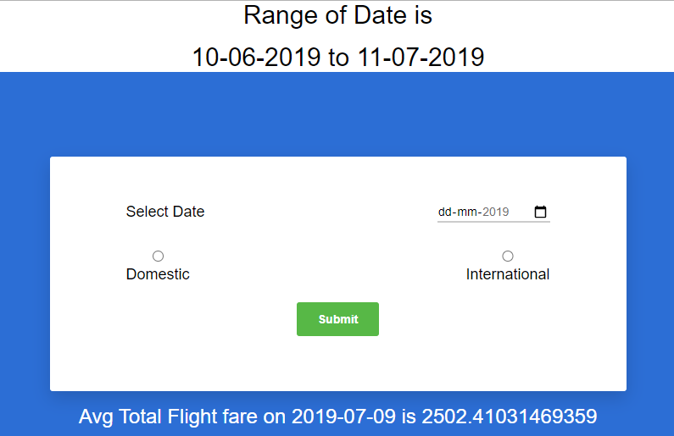
Deployment

Slide 17
Thanks!
Does anyone have any questions?
anupprakash467@gmail.com
gowthamthenarasut@gmail.com
shrikant.datacamp@gmail.com
abhishekwithu101@gmail.com

